Slide 1


Is the Price Reasonable?
Xinyi Gong, Lanyu Shang, Yang Sun

Slide 2
Role & Problem

Slide 3
Role & Problem:
Role: Guest
Problem: Is the price reasonable?
Location: San Francisco

Slide 4
In-Sample Modeling

Slide 5
Data Overview
“listing.csv”: 8720 listings and 95 variables.
Target Variable: “price”
33 predictors are selected.

Slide 6
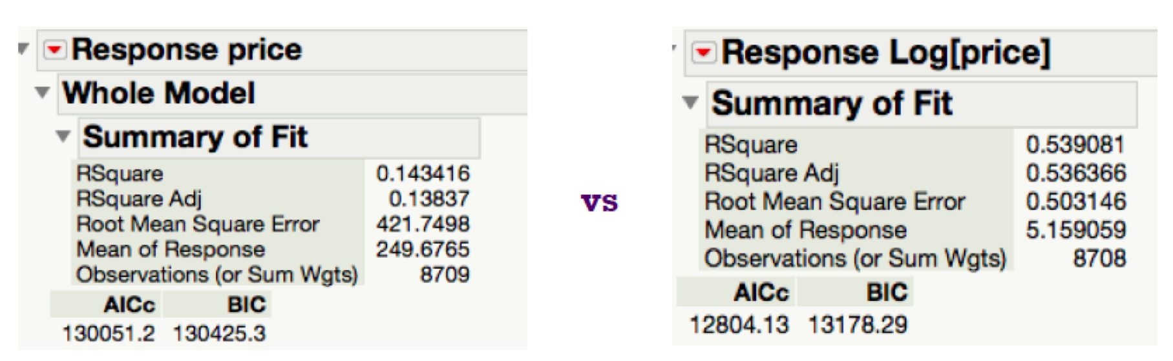
Model Comparison
Linear Regression vs Semi-log Regression

Slide 7
Factor Analysis
Several predictors have similar meanings.
Factor analysis particular useful when predictors are highly correlated.

Slide 8
Clustering
Group similar records into the same cluster (useful in later classification algorithm).
Find outliers to ensure model accuracy.

Slide 9
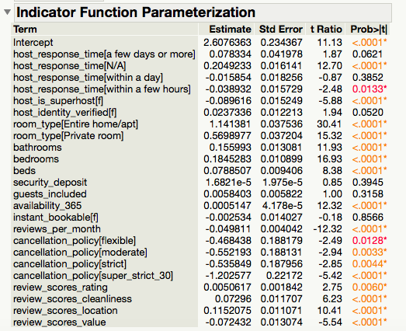
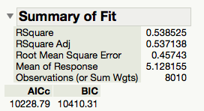
Final model features & coefficients

Slide 10
Recall
The constructed regression model helps us to predict a reasonable price, given guests’ preferences.
We will apply multiple machine learning algorithms to better classify if a listed price is reasonable.

Slide 11
Out-Sample Modeling

Slide 12
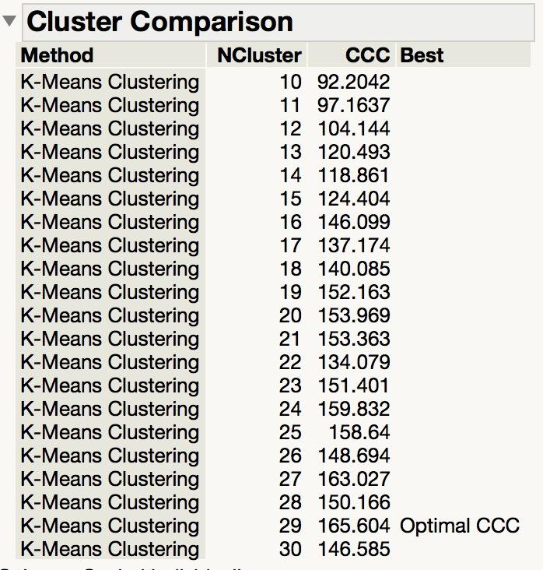
Pre-processing: Target
Target:
{“underpriced”, “reasonable”, “overpriced”}
Step 1: K-Means Clustering
Optimal CCC:
29 Clusters
“price_benchmark”:
mean price in each cluster

Slide 13
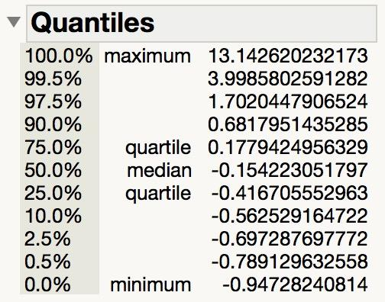
Pre-processing: Target
Target:
{“underpriced”, “reasonable”, “overpriced”}
Step 2: Percentage Difference =
“price” - “price_benchmark”
“price_benchmark”

Slide 14
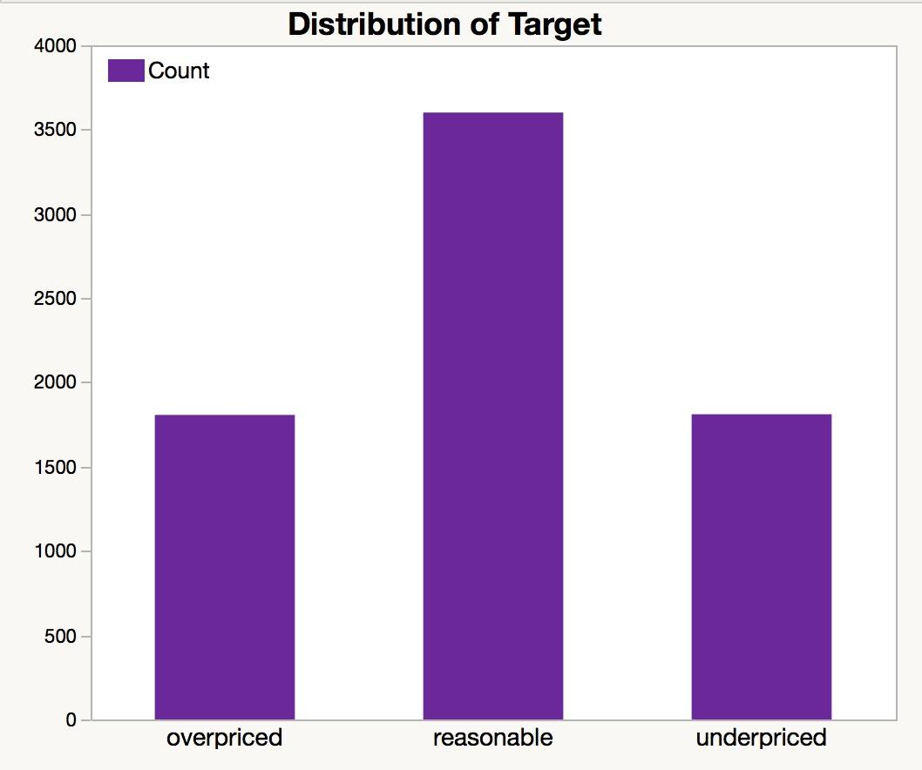
Pre-processing: Target
Target:
{“underpriced”, “reasonable”, “overpriced”}
Step 3: Create Target
“Underpriced”: lower than 1st quantile
“Reasonable”: between 1st and 3rd quantile
“Overpriced”: higher than 3rd quantile

Slide 15
Pre-processing: Text
“review2.csv”
Remove Reviews:
Not in English
Automated: "This is an automated posting"
Invalid
Combine reviews associated with the same “listing id” and merge with listing records.
Lowering letters, stemming, removing punctuations, stopwords and numbers.

Slide 16
Text Mining

Slide 17
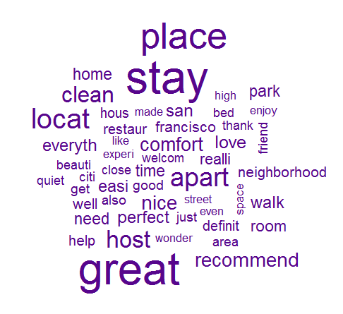
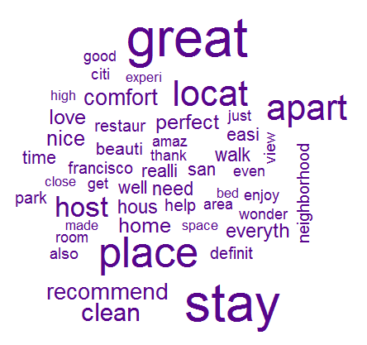
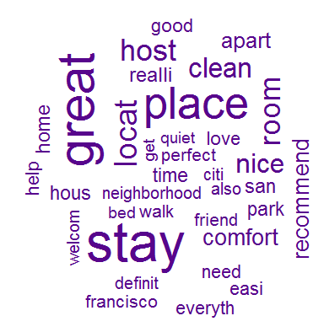
Comparing Frequent Terms
Reasonable Overpriced Underpriced

Slide 18
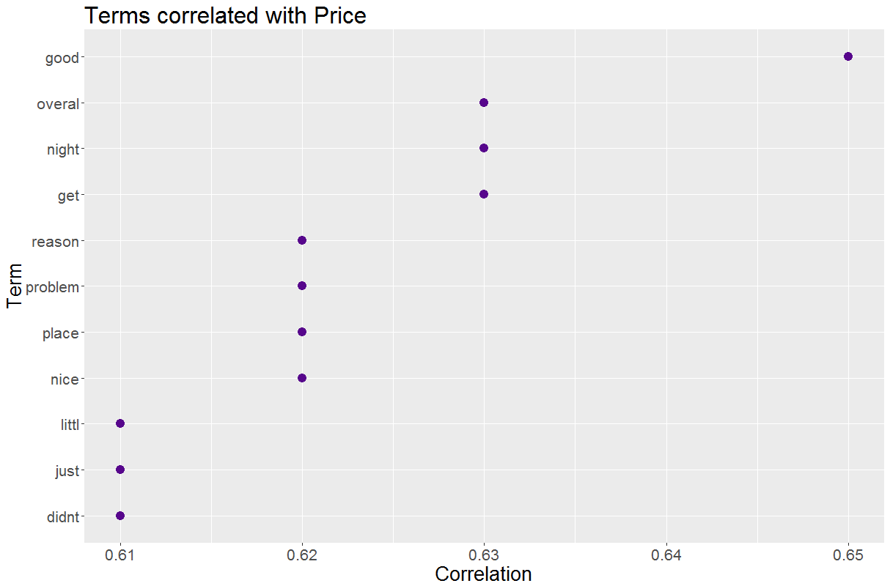
Terms Correlated in “Reasonable”
“Good” is the highest correlated word, which indicates that customers are fairly satisfied.

Slide 19
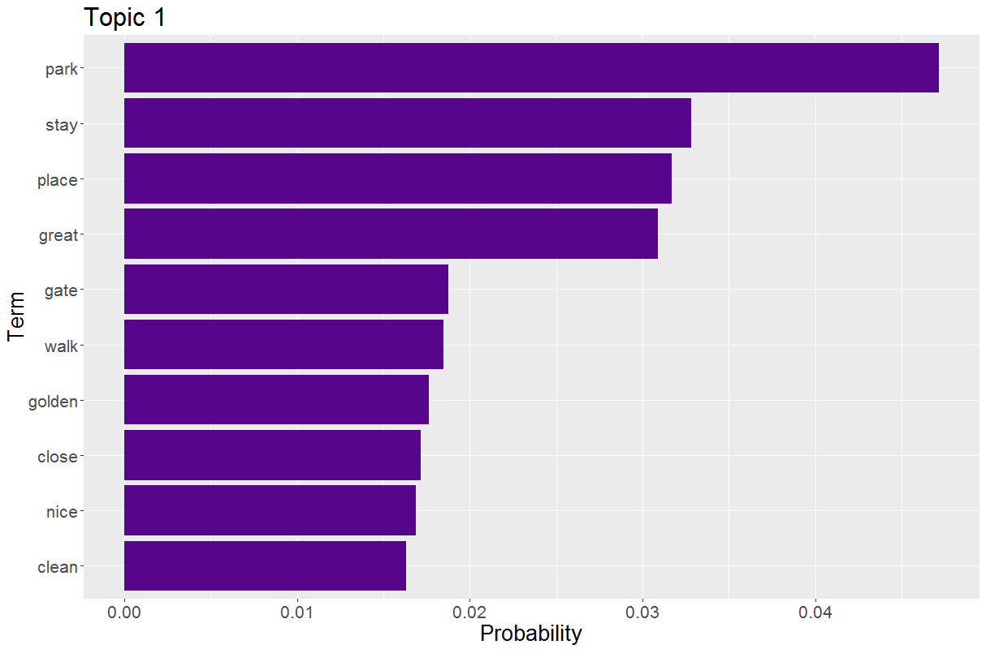
Top Topic in “Reasonable”
About the distance to the scenic spots.

Slide 20
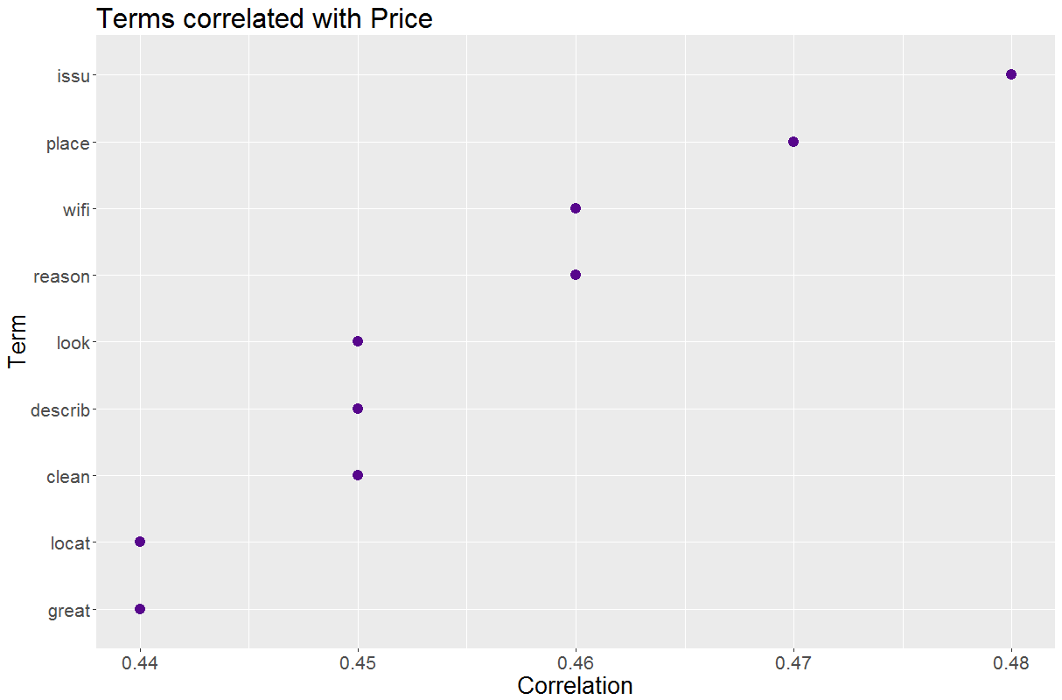
Terms Correlated in “Overpriced”
“Issue” is the highest correlated word with “price”, which may cause the disagreement on price.

Slide 21
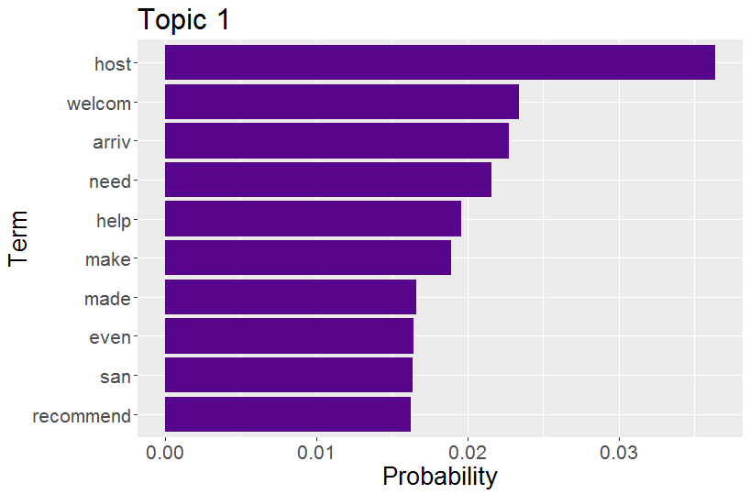
Top Topic in “Overpriced”
About the customer services (could be the reason for the extra fees).

Slide 22
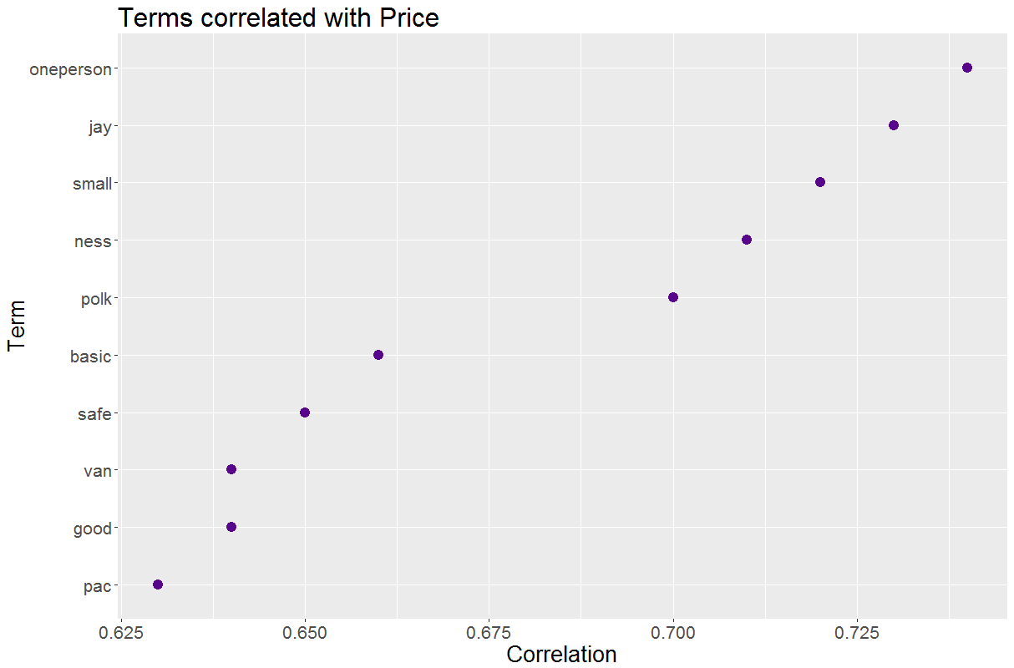
Terms Correlated in “Underpriced”
Terms such as “oneperson”, “small” and “basic” are likely to be related with a single person’s room, which has small space and basic amenity.

Slide 23
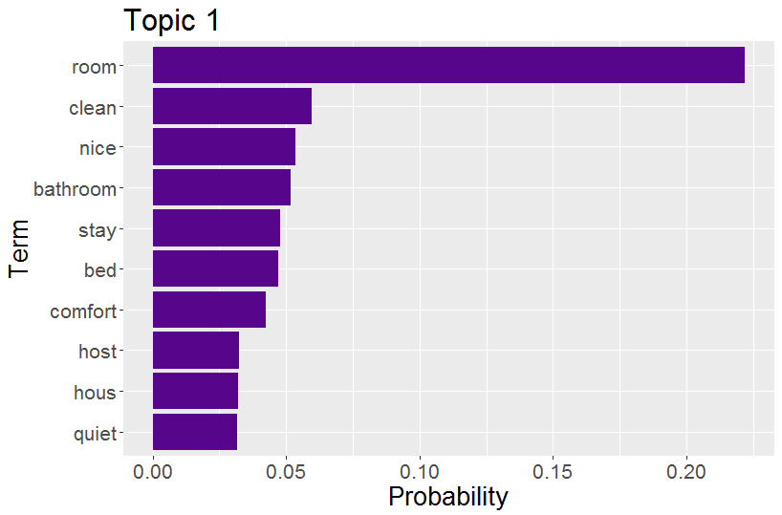
Top Topic in “Underpriced”
Terms such as “clean”, “nice” and “quiet” are positive words, which may show that hosts’ listed prices are below customers’ expected range.

Slide 24
Conclusion for Text Mining
The frequent terms in these 3 classes are not significantly different (many positive words).
Sentiment analysis could be used to predict rating, instead of prices (our dependent variable).
Therefore, use rating for the price prediction could be enough.

Slide 25
Multiclass Classification

Slide 26
Machine Learning
Variables
Methods
Target:
{“underpriced”, “reasonable”, “overpriced”}
10 Nominal Variables
19 Continuous Variables
Logistic Regression
Bootstrap Forest
Neural Networks

Slide 27
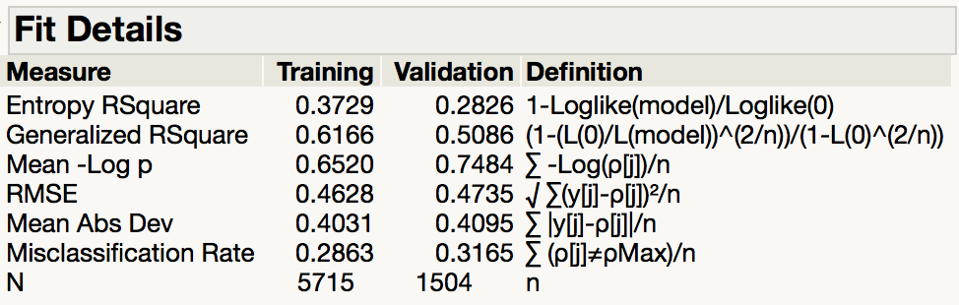
Logistic Regression

Slide 28
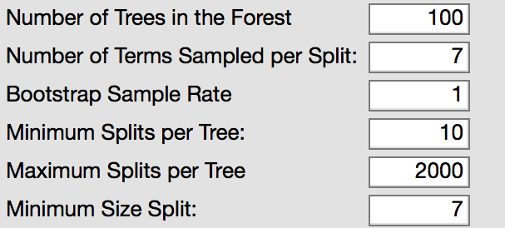
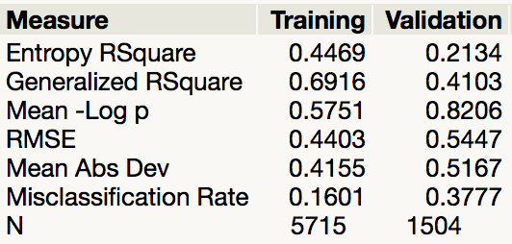
Bootstrap Forest
Parameters by default

Slide 29
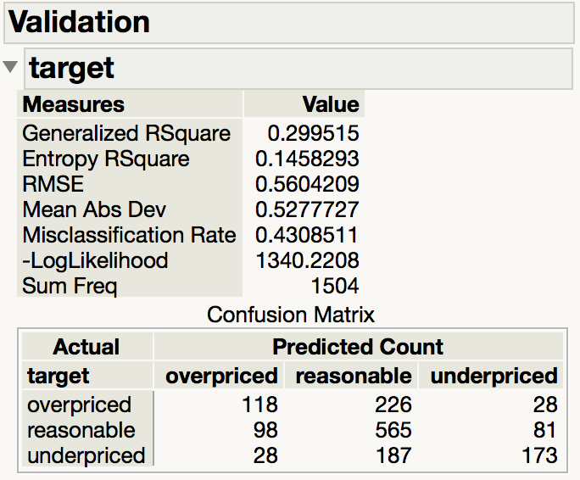
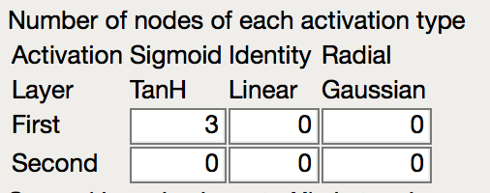
Neural Networks

Slide 30
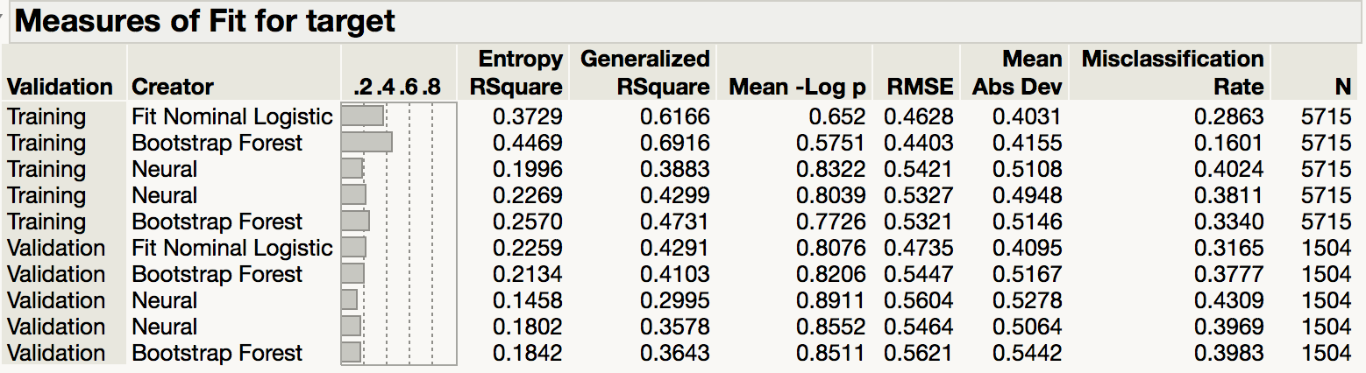
Model Comparison

Slide 31
Discussion

Slide 32
Discussion
Generally, sentiment analysis is used to predict ratings, so we cannot apply “review words” and ratings simultaneously to make classifications
The predictive power of sentiment analysis and ratings are “overlapped”.
Hierarchical clustering seems better at searching for outliers; k-means cluster can group similar records to make labels for classification.

Slide 33
THANK YOU

